Slide 1
Facial Expression recognition (FER)
Jingyi Zhang, Haoxian Ruan, Andrew Nguyen and Adam Mhal
jyz0328@bu.edu, rhx2000@bu.edu, aynguyen@bu.edu , adammhal@bu.edu
link for google drive: https://drive.google.com/drive/u/1/folders/1MdR9WIQ8Kbv_Aq7Bg2KntPREfKzp0Utv

Slide 2
Task
Our task is to develop a facial expression recognition (FER) system that can accurately classify human facial expressions such as: “angry”, “disgust”, “fear”, “happy”, “sad”, “surprise”, and “neutral”. The main challenges of this task include:
(1) Distinguishing similar expressions such as "surprise" and "fearful."
(2) Handling different conditions: The model needs to work well even when lighting, camera angles, or things like glasses and masks affect the face.
(3) Adapting to different people: The model should recognize expressions correctly across various ages, genders, and ethnic backgrounds.
Notes:
Hi we are jingyi haoxian andrew and adam, our project is to develop a facial expression recognition system….

Slide 3
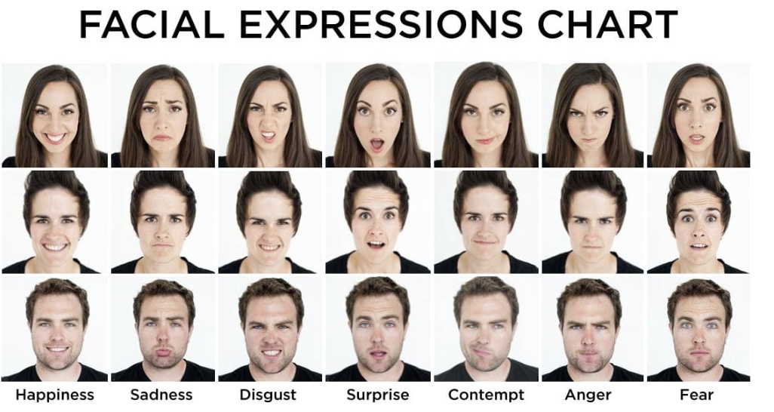
An example
Notes:
here is an example chart, our task is to reconginize these emotions correctly

Slide 4
overview of our approach and working
baseline: CNN, RESNET, VGG
CNN/RESNET/VGG result compare
CNN IMPROVEMENT
RESNET IMPROVEMENT
ADDITIONAL:GAN

Slide 5
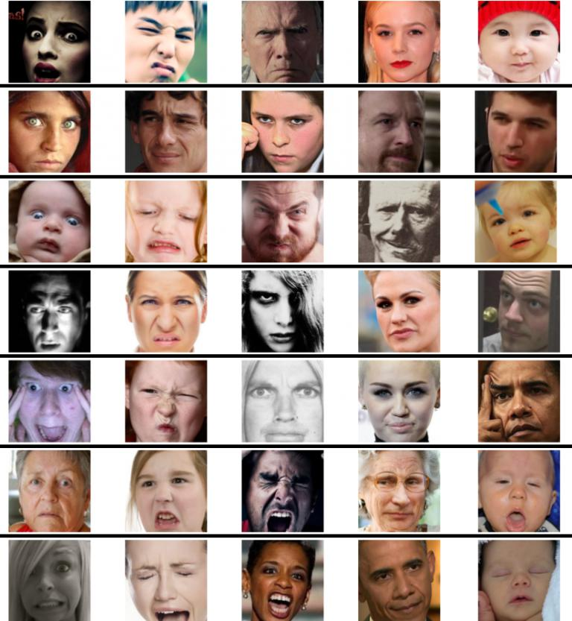
Dataset - AffectNet
Using a mini version of the Affectnet Dataset (~280,000 images)
Covers the following emotions: 0: Neutral, 1: Happiness, 2: Sadness, 3: Surprise, 4: Fear, 5: Disgust, 6: Anger, 7: Contempt
Training set: ~200k, Validation set: ~40k, Test set: ~40k

Slide 6
Metrics
Performance of our models is measured by accuracy and validation loss
Training and validation loss and accuracy is monitored over epochs to detect underfitting, overfitting, or instabilities
Final performance is measured by test set accuracy and a confusion matrix covering predicted vs true labels

Slide 7
CNN feature and principle
Designed for grid-like data, such as images or audio signals
Uses local receptive fields: small filters scan across the input to capture local patterns
Weight sharing drastically reduces the number of parameters
Stacking convolution and pooling layers progressively extract hierarchical features
Highly scalable and efficient, widely used in computer vision tasks
Notes:
CNN is what we are all familiar with, it is mainly used to process data with spatial structure, such as 2D images and 1D audio.

Slide 8
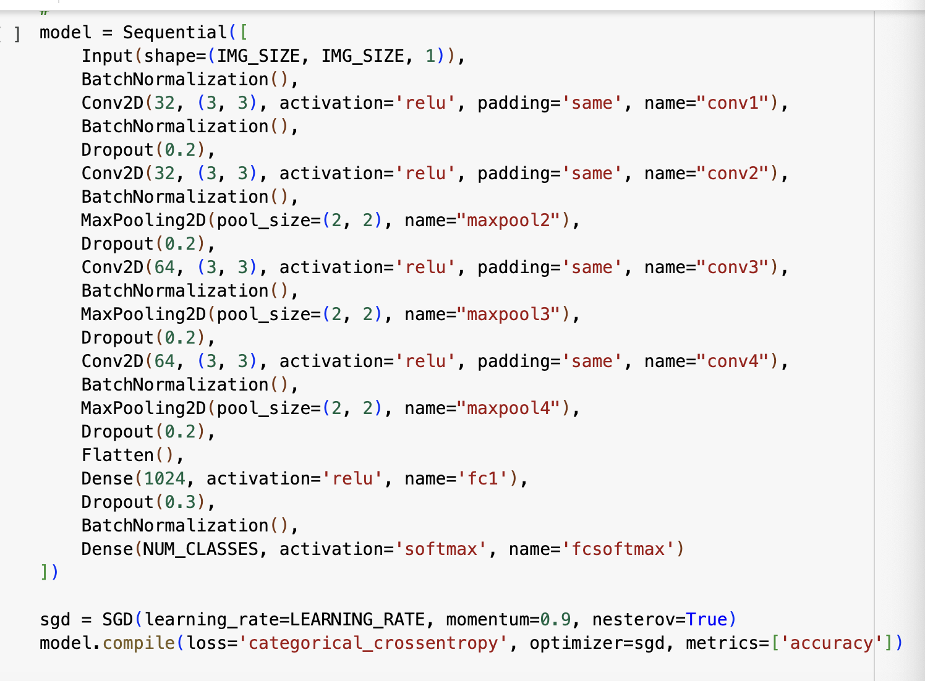
CNN- baseline code build
We decided to use the CNN network in Kim et al.[1] which achieved a high accuracy on FER dataset as our baseline model.
It’s a five-layer model, built from 4 sequential convolutional blocks that progressively deepen from 32→32→64→64 filters. Each block applies a 3×3 convolution (ReLU, “same” padding), followed by batch normalization and dropout, and we insert 2×2 max‐pooling after blocks 2–4 to downsample. After the 4th block, the feature maps are flattened and passed through a 1024-unit fully-connected layer (with dropout and batch normalization), then into a softmax output layer over the eight emotion classes.
[1] B.-K. Kim, S.-Y. Dong, J. Roh, G. Kim, and S.-Y. Lee, “Fusing Aligned and Non-Aligned Face Information for Automatic Affect Recognition in the Wild: A Deep Learning Approach,” in IEEE Conf. Computer Vision and Pattern Recognition (CVPR) Workshops, 2016, pp. 48–57.
Notes:
And We decided to use the CNN network built in a related paper which achieved a high accuracy on FER dataset as our baseline model. It’s a five-layer model, which has 4 convolutuonal blocks and 1 fully connected layer.

Slide 9
RESNET-feature and principle
Introduces residual connection (Skip Connection)
Residual block formula: z=F(x)+x
F(x): Two convolutions + BatchNorm + ReLU
if input and output have Different channels → Adjusted by 1×1 convolution
Eases vanishing gradients, enables deeper networks
Notes:
ResNet introduces residual connections, also known as skip connections, by adding the input back to the output, following the formula z = F(x) + x.
F(x) is transformation of two convolution layers, batch normalization, and ReLU.

Slide 10
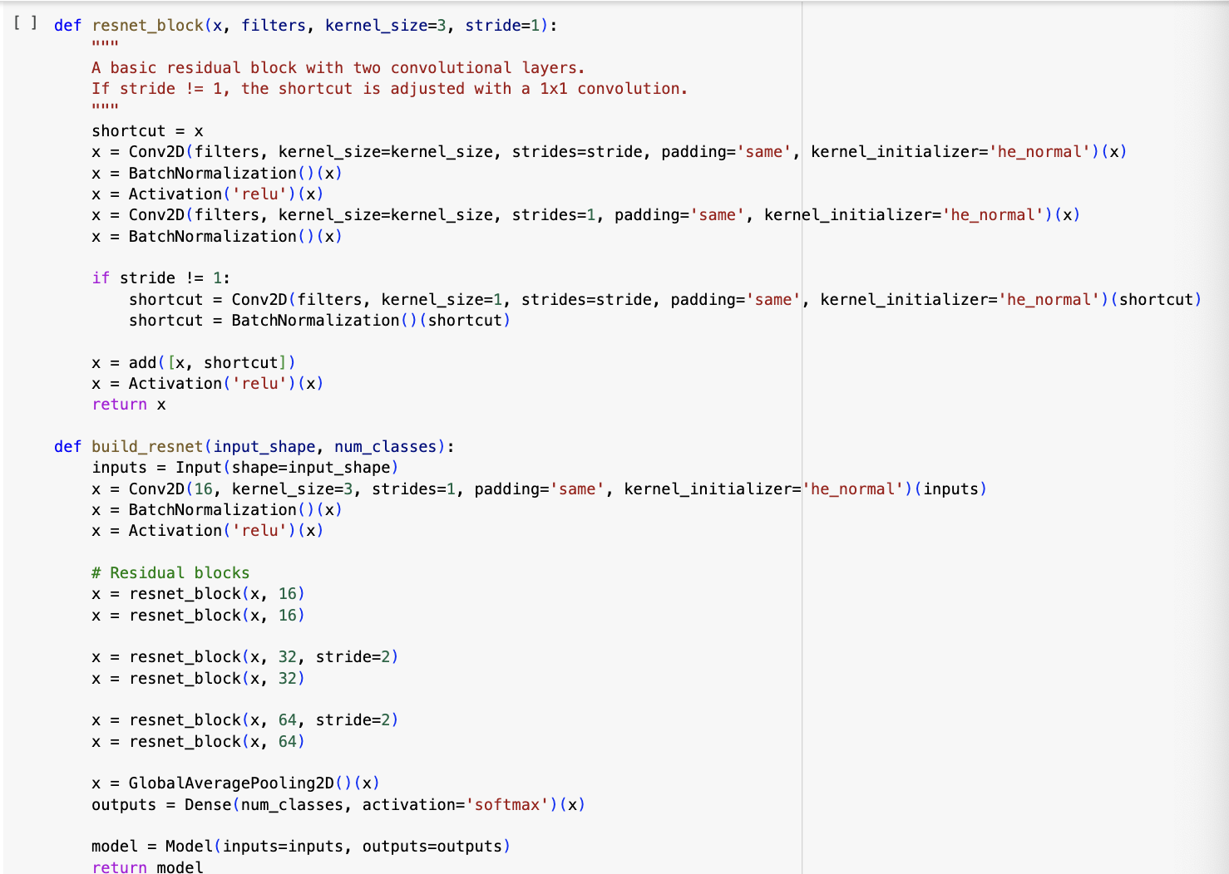
RESNET- baseline code build
Define Residual Block:
Two 3×3 convolutions + BatchNorm + ReLU
Add skip connection (adjust with 1×1 conv if needed)
Network Structure:
Initial 3×3 convolution (16 channels)
2 residual blocks with 16 channels
2 residual blocks with 32 channels
2 residual blocks with 64 channels
Global Average Pooling → Dense classification layer
Notes:
In our ResNet baseline, we start with a 3×3 convolution, followed by several residual blocks.
As we go deeper, the number of channels increases, and finally we use global average pooling before classification.

Slide 11
VGG-feature and principle
Visual Geometry Group, firstly proposed by University of Oxford
Stacks small 3×3 convolutions for feature extraction
Inserts MaxPooling after every 2–3 layers to progressively reduce the featured map size
Improves non-linearity with multiple small convolutions
Simple, uniform structure, easy to extend
Notes:
VGG builds features by stacking multiple small 3×3 convolutions.
MaxPooling layers are inserted after every two or three convolution layers to reduce the feature map size.

Slide 12
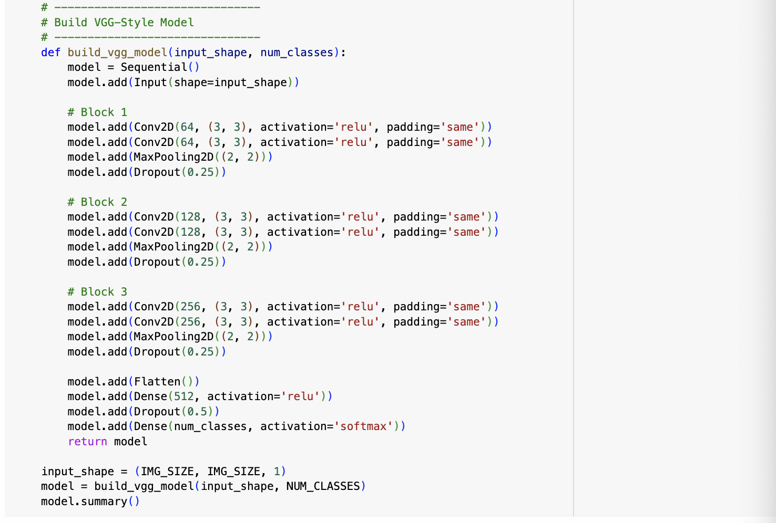
VGG- baseline code build
Define VGG-Style Block:
Two 3×3 convolution layers with ReLU activation per block
MaxPooling after each block
Channels gradually increase: 64 → 128 → 256
Flatten and connect to one fully connected layer with Dropout
Final softmax output for emotion classification.
Notes:
In our VGG baseline, each block has two 3×3 convolution layers with ReLU activation, followed by MaxPooling.
The number of channels increases from 64 to 128, and then to 256.

Slide 13
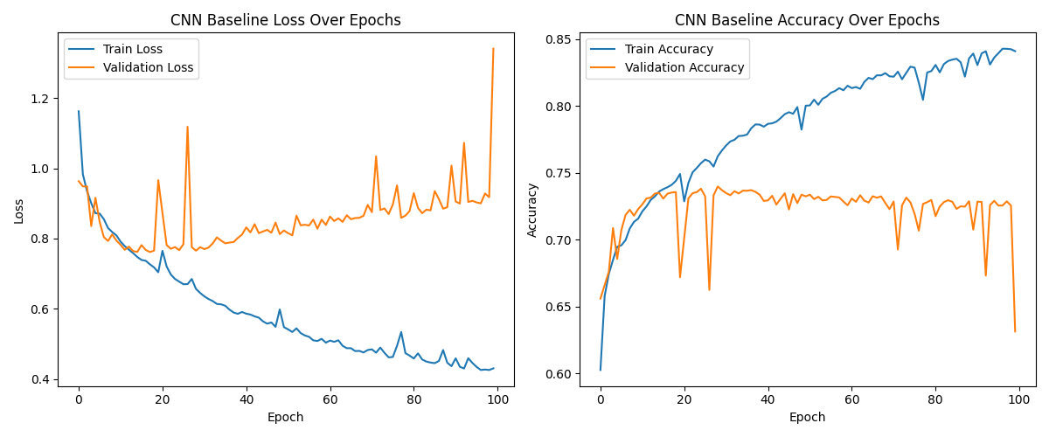
Notes:
cnn的training accouracy稳步桑上升到0.85左右，traning loss稳定下降到0,4左右，validation的loss和accuracy有些波动但是总体走势平稳，不过validation accuracy最高只到0.75左右，但我们在之后的implement部分会进行优化的介绍
For CNN, the training accuracy steadily increased to 0.85, while the training loss steadily dropped to about 0.4.
The validation accuracy and loss had some ups and downs, but overall they stayed pretty stable.

Slide 14
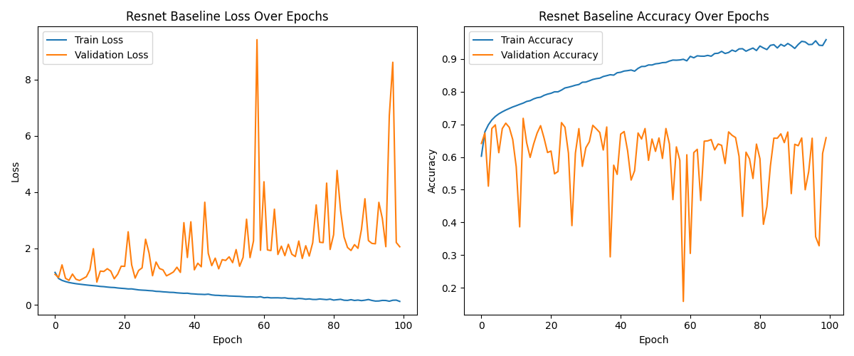
Resnet
Notes:
resent的training accouracy稳步桑上升到0.9左右，traning loss稳定下降到0,2左右，但是validation的loss和accuracy非常陡峭变化不定，甚至总体上validation accuracy呈现下降趋势，这代表着可能出现过拟合，但是因为traning的优秀表现，我们还是在后续进行了优化
For ResNet, the training accuracy steadily increased to 0.9, and the training loss steadily dropped to 0.2.
However, the validation loss and accuracy changed sharply and irregularly, with the validation accuracy even showing an overall downward trend.
This suggests possible overfitting.

Slide 15
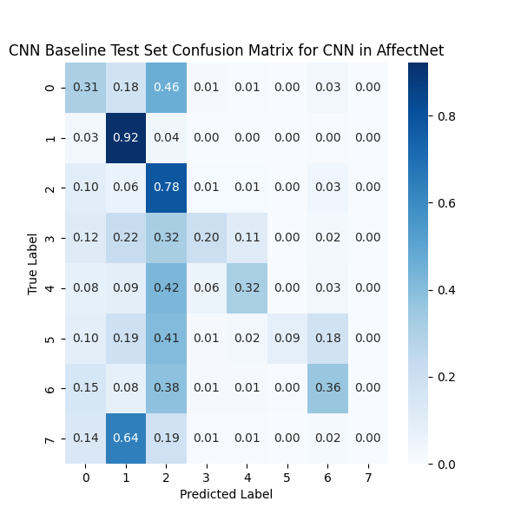
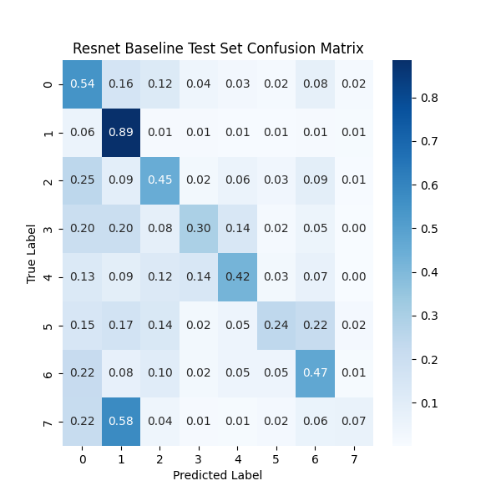
0: Neutral, 1: Happiness, 2: Sadness, 3: Surprise, 4: Fear, 5: Disgust, 6: Anger, 7: Contempt
Notes:
Here are the confusion matrices for the two models.
Labels 0 to 7 represent different emotions.
If the numbers on the diagonal are close to 1, it means the model is doing a good job.

Slide 16
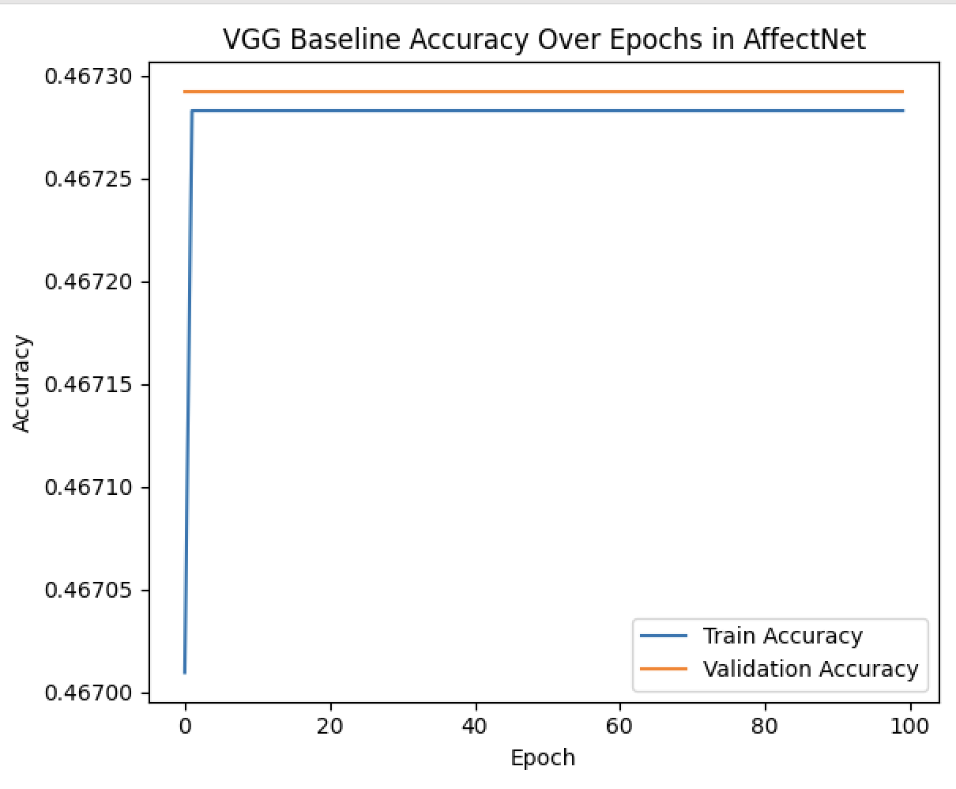
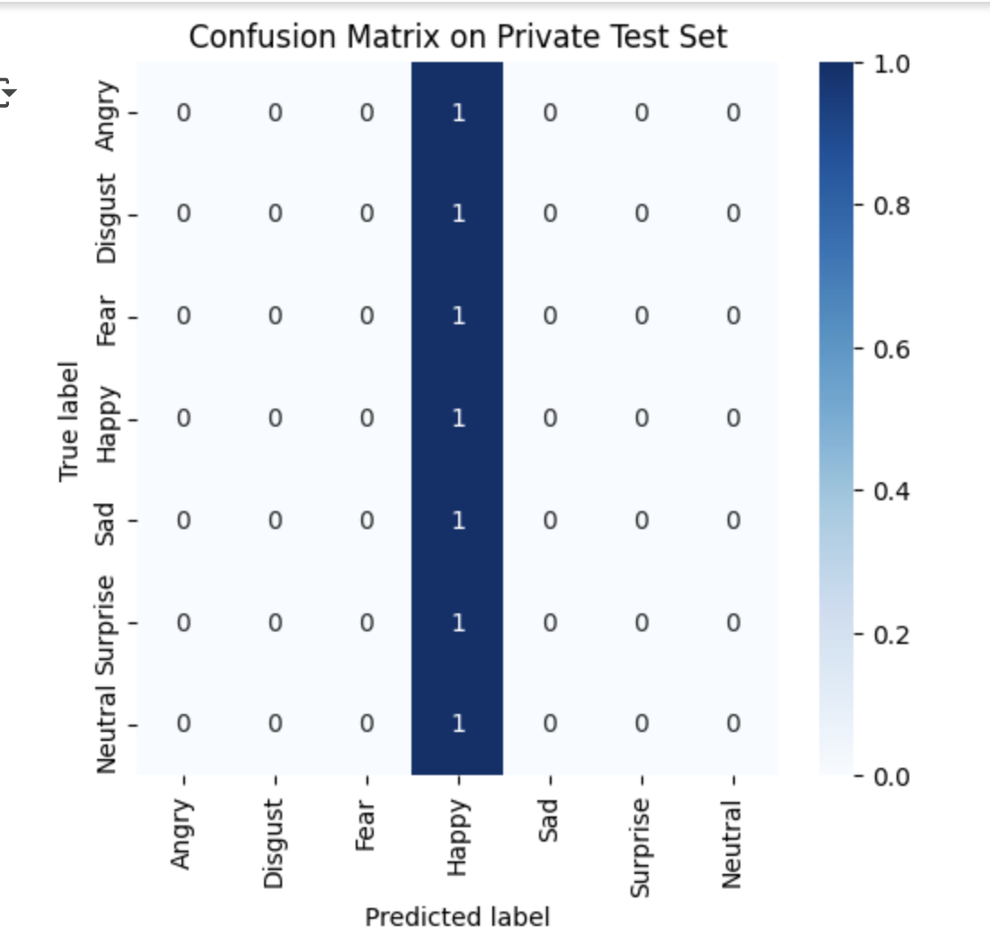
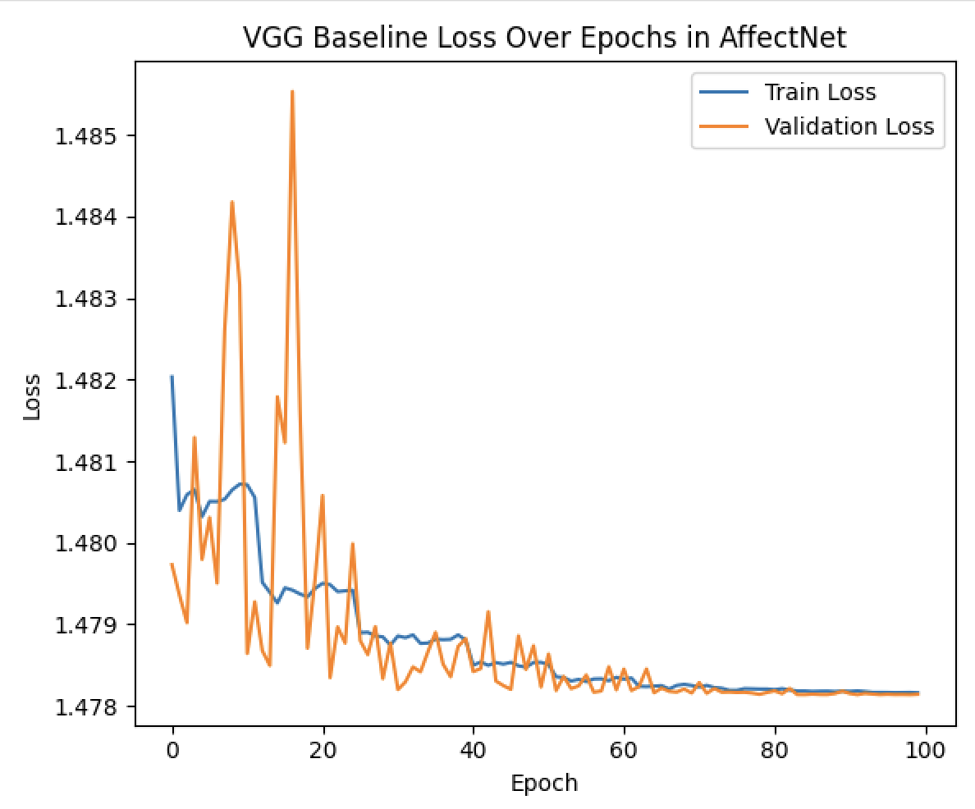
however for vgg
Notes:
The VGG model showed poor performance.
Both training and validation accuracy remained low, around 47%, with almost no improvement over the epochs.
from the confusion matrix, we could see it ONLY predicted the "happy" emotion.

Slide 17
baseline compare
model/data | Val | Val | Test | Test
 | loss | accuracy | loss | accuracy
CNN | 1.35 | 0.63 | 1.35 | 0.63
Resnet | 2.06 | 0.65 | 2.05 | 0.66
VGG | 1.48 | 0.47 | 1.48 | 0.47
red value implies bad performance
Notes:
CNN and ResNet achieved 66–68% accuracy, while VGG has low accuracy.
CNN loss is 1.35,VGG loss is 1.48,while Resnet loss is 2.06 , which is high

Slide 18
baseline performance summary
CNN: Stable training and validation performance, with low loss and reasonable accuracy .
ResNet: High and stable training performance, but exhibited instability in validation loss and signs of potential overfitting.
VGG: Perform bad, with very low accuracy (~24–25%) and no improvement across epochs.
Final Decision:Improvement CNN and ResNet , give up VGG.
Notes:
CNN good an stable
ResNet good in training but unstable validation
VGG poor performance
improve CNN and ResNet

Slide 19
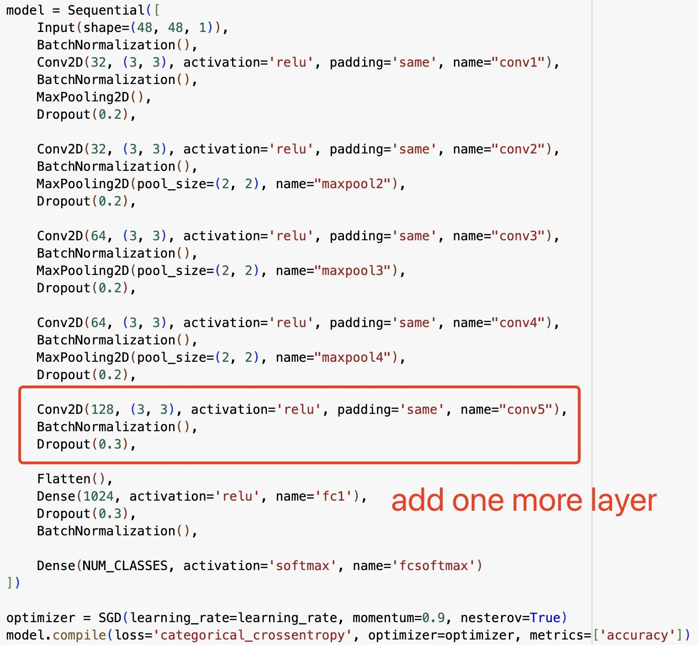
improvement-CNN
Improve the network from structure
(a) add one more conv2d(128) layer
(b) add conv2d(128) layer + conv2d(64)
(c) delete one layer
Notes:
We wanna build a better CNN. We first tried to improve the network structure by add one more layer, and then tried add one more layer again, and also tried to delete one layer from the baseline model. and each network was trained and evaluated for 20 epochs under the same conditions. The results indicate that model (a), with one additional layer, achieved the best performance among the three modifications.

Slide 20
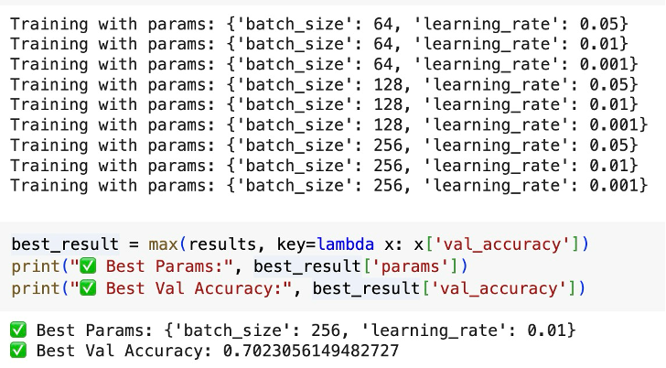
improvement--CNN
2. Hypertuning: batch_size + learning_rate
Perform a grid search over batch sizes of 64, 128, and 256 and learning rates of 0.001, 0.005, and 0.01 to find the optimal hyperparameters.
Notes:
We then performed hypertuning on two parameters which are batch size and learning rate, and the grid search result gave us a best parameter combination. The batch size should be 256 and the learning rate should be 0.01.

Slide 21
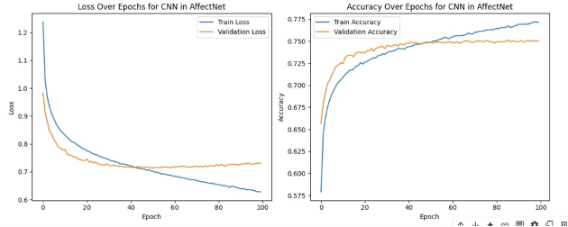
improvement--CNN
Notes:
And then we train the network for 100 epochs, the plot shows that the training process was very steady, the model fits well.

Slide 22
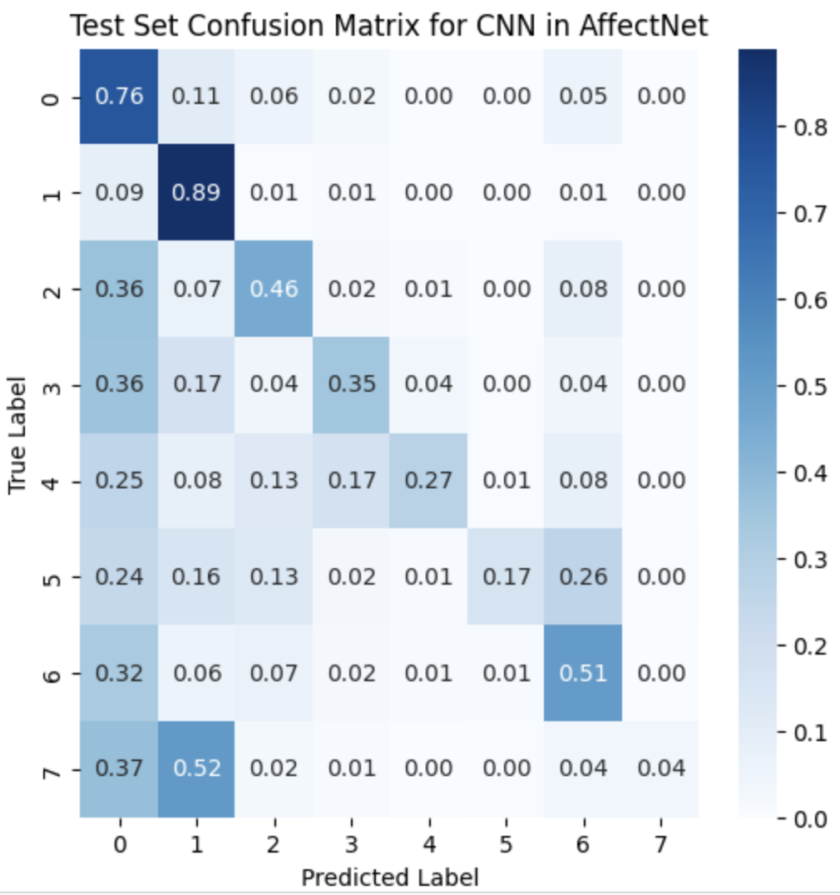
before improvement
after improvement
Notes:
0: Neutral, 1: Happiness, 2: Sadness, 3: Surprise, 4: Fear, 5: Disgust, 6: Anger, 7: Contempt

Slide 23
improvement-CNN
metrics | best_model | baseline model
train_loss (average of 3 seeds) | 0.63 | 1.17
val_loss (average of 3 seeds) | 0.75 | 1.35
train_accuracy (average of 3 seeds) | 0.77 | 0.84
val_accuracy (average of 3 seeds) | 0.75 | 0.63
All results are averaged over three runs with different random seeds.
Notes:
Although the baseline model have a better performance on training set, the hypertuned model delivered better prediction result. As we can see, the best_model has lower validation loss and higher validation accuracy than the baseline model.

Slide 24
improvement - RESNET improvements
Squeeze and Excitation Block
Adds an attentional component to the model to boost affect of useful features and suppress irrelevant ones
Data Augmentation
Added random flips to the data to reduce overfitting to the train set
Larger input data size
Earlier used low res 48x48 grayscale images
Used 224x224 RGB images so features can be extracted better and it can hopefully pick up on slight facial variations between emotions
Adam optimizer
converges faster than SGD and useful for datasets like Affectnet
Notes:
To attempt to improve our baseline RESNET performance, we use a resnet50 architecture with 50 weight layers. We added in an SE block or squeeze and excitation. This is an attentional layer and allows the model to focus on features such as mouth and eyes rather than the background. We also added data augmentation such as random horizontal flips in order to avoid overfitting/memorization of the train set. For our data, larger input size has more details and more features that the model can pick up on. The adam optimizer adapts the learning rate. affectnet is large and multidimensional

Slide 25
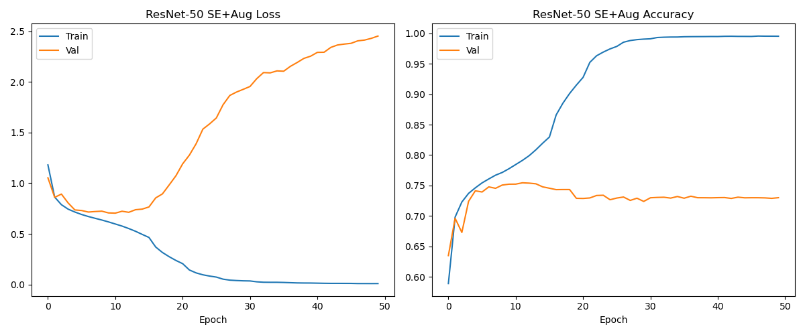
RESNET improvement- Results
Notes:
These are the loss and accuracy plots of the training and validation sets during the resnet training. As you can see the training accuracy reaches almost 100% showing overfitting despite added data augmentation. To combat this I have adding weight decay to our adam optimizer, early stopping, and even more data augmentation

Slide 26
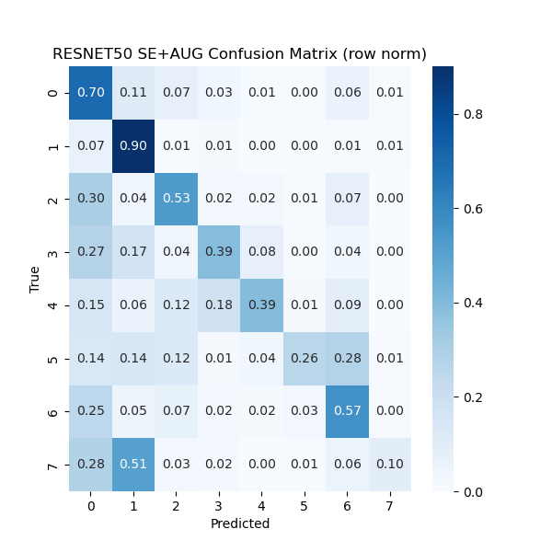
RESNET improvement- Results
Final Test Accuracy: 72.87%
0: Neutral, 1: Happiness, 2: Sadness, 3: Surprise, 4: Fear, 5: Disgust, 6: Anger, 7: Contempt
Notes:
This is our confusion matrix for the output of the resnet model. It has been normalized for each row/column to add up to 1 because there are not even amounts of images for each face. final test accuracy for this model was 72.87%

Slide 27
GAN Motivation
Goal was to add complexity beyond pure classification
GAN adds data diversity and enables synthetic test set
Transfer Emotions
GAN would generate a face that takes an emotion from an “emotion” face (happy, sad, etc.) and maps it onto a face with a neutral face
Synthetic Testing
Evaluate transfer accuracy against real photos
Data augmentation
Long-term goal is to fill in gaps in rare emotions (i.e. disgust) underrepresented in the datasets

Slide 28
GAN: Two-Stage Pipeline
Stage 1: CNN Classifier
Filter generated samples to ensure they match the intended sample
Necessary so that the GAN does not produce artifacts or drifts in expression
Provides the additional benefit that we only keep images that are classified correctly by the CNN, preventing label noise
Stage 2: Conditional GAN Generator / Discriminator
Generator: Creates a new face given neutral + expression reference
Discrminator: Judges real vs. fake, driving generator to improve realism

Slide 29
GAN: Single-Folder Data Strategy
Mixed Emotions in One Directory
Contains neutral, happy, sad, angry, and other faces which are all unlabeled at pairing time
Unpaired Sampling Mechanism:
Random pairing encourages the model to learn expression disentanglement rather than memorize pairs
Identity-Agnostic Learning
Forces abstraction of “what makes an angry face angry” across different subjects

Slide 30
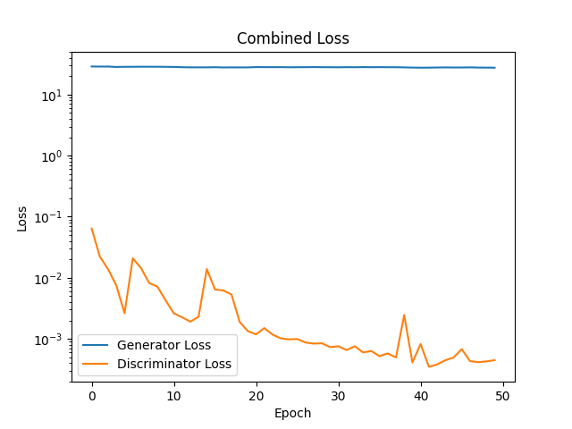
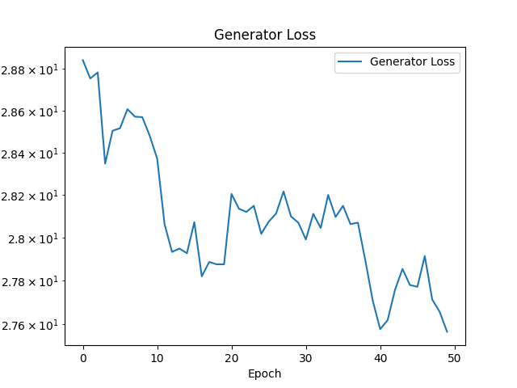
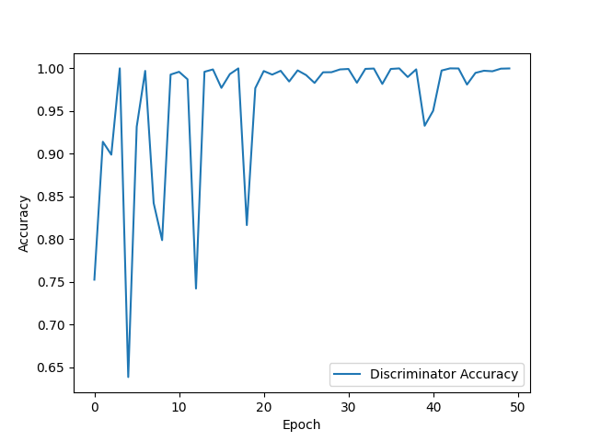
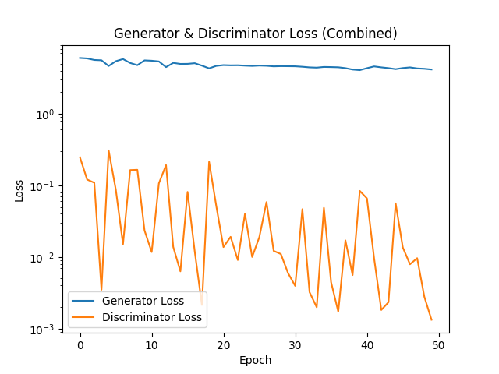
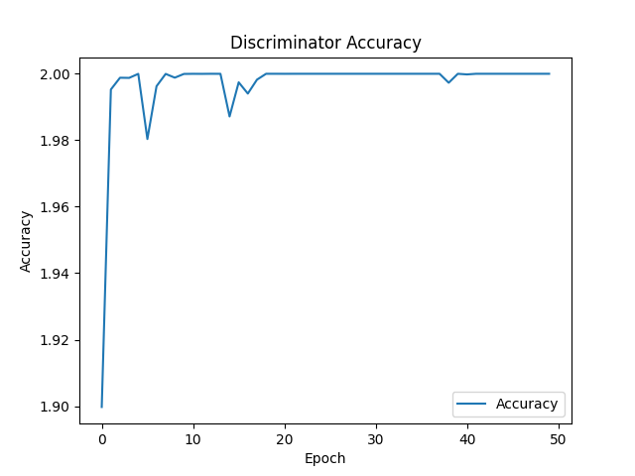
Quantitative Results (GAN)
Single-Folder Data
Separated Data

Slide 31


Reference Images (GAN)
Emotion Face
Neutral Face

Slide 32
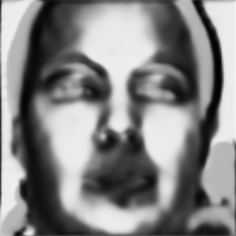
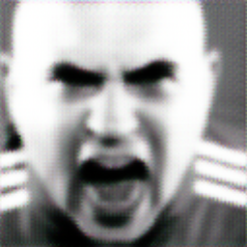
Qualitative Results (GAN)
Single-Folder Data
Separated Data

Slide 33
any questions?

